Slide 1
STOCK MARKET FORECASTING USING TIME SERIES ANALYSIS
UNDER THE SUPERVISION OF
SRI. PHULEN MAHATO
SUBMITED BY
chITRANKU SARKAR
rOLL NO: 6241107-07171
rEG. NO: 1032111400447
SUBHODEEP SAHA
rOLL NO: 6241107-07174
rEG. NO: 1032111600471
avrodeep pAL
rOLL NO: 6241107-07164
rEG. NO: 1032111600442

Slide 2
introduction
The stock market is a place where stocks representing company ownership are bought and sold.
implementing the concept of algorithmic trading which uses automated, pre-programmed trading strategies to predict stock prices.
time series forecasting (predicting future values based on historical values) applies well to stock forecasting.
Machine learning models like SVR, ANN, and rNN have improved time series forecasting.
LSTM networks excel in stock prediction by storing and utilizing past information effectively.

Slide 3
motivation
The unpredictable nature of the stock market drives the need for advanced predictive models.
accurate stock price prediction, Improved predictive models help investors make informed decisions, reducing financial risks.
Advancements in machine learning offer new opportunities to enhance time series forecasting accuracy.
The success of LSTM networks in other domains inspires their application to stock market prediction.

Slide 4
objective
The main objective of our model is to predict the close price of a stock by analyzing complex historical data of the same, using Long Short-Term Memory (LSTM) networks by executing the following taks.
Load Stock Data (as a .CSV file) and Pre-process it
Prepare Dataset and Define the LSTM Model
Combine train and test predictions to get final prediction
Train the models for each component
Show (plot) predicted vs actual values for the test set

Slide 5




technology used
Python Language
Python is a rich
language for Data
Science and AI
Libraries Used
pandas, sklearn, numpy,
tensorflow, etc.
Algorithm
Long Short Term Memory
(LSTM)
Environment
Google Colab is a cloud-based platform to execute Python codes.

Slide 6
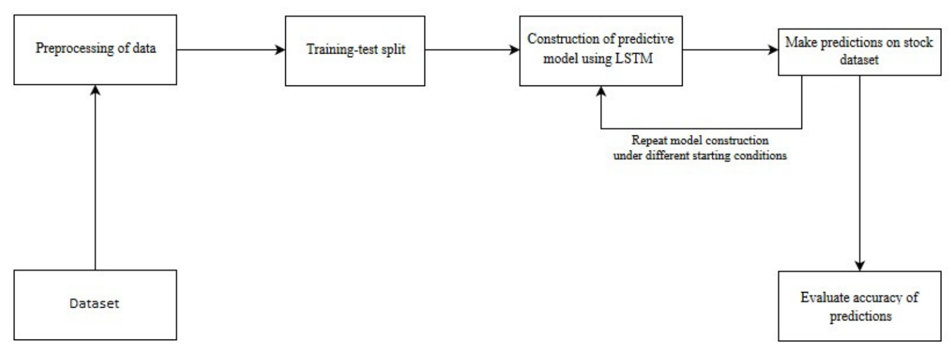
generic model for stock market forecasting

Slide 7
Dataset
The dataset used in this project is TSLA (Tesla) from June 29, 2010 to December 31, 2020. This is a series of data points indexed in time order or time series. Our goal
was to predict the closing price for any given date after training.
Date | Open | High | Low | Close | Adj Close | Volume
29-06-2010 | 3.8 | 5 | 3.508 | 4.778 | 4.778 | 93831500
30-06-2010 | 5.158 | 6.084 | 4.66 | 4.766 | 4.766 | 85935500
01-07-2010 | 5 | 5.184 | 4.054 | 4.392 | 4.392 | 41094000
02-07-2010 | 4.6 | 4.62 | 3.742 | 3.84 | 3.84 | 25699000
06-07-2010 | 4 | 4 | 3.166 | 3.222 | 3.222 | 34334500
07-07-2010 | 3.28 | 3.326 | 2.996 | 3.16 | 3.16 | 34608500
08-07-2010 | 3.228 | 3.504 | 3.114 | 3.492 | 3.492 | 38557000
09-07-2010 | 3.516 | 3.58 | 3.31 | 3.48 | 3.48 | 20253000
12-07-2010 | 3.59 | 3.614 | 3.4 | 3.41 | 3.41 | 11012500
Table 1: TESLA Stock Data

Slide 8
data preprocessing
The Steps of Preprocessing of Data is shown below:
Load Stock Data (as a .CSV file)
Read the CSV file.
Convert the 'Date' column to datetime.
Set 'Date' as the index.
Filter Data
Exclude data after 2020-12-31 due
to too much noise (COVID-19 effect).
Resample Data
Resample to weekly frequency using the
mean of daily adjusted close prices.
Seasonal Decomposition and
drop NaN values
Perform seasonal decomposition with a multiplicative
model and a period of 52 weeks.
Extract trend, seasonal, and residual components.
Drop Not a Number values.

Slide 9
data preprocessing
Normalize the 'trend', 'seasonal', and 'residual' components to a range of 0 to 1, ensuring all values fall within this interval.
Fit and transform each component to achieve uniform scaling, improving model training and performance.
Scale Data
Split Data
Split the data into training and testing sets
(last 24 months for testing).
Prepare Dataset
Define the number of previous weeks (n_input) to use for prediction.
Set the number of weeks to predict (n_output).

Slide 10
STOCK PRICE PREDICTOR MODEL
As the name suggests, the Stock Price Predictor Model is designed to forecast the close price of a stock by analyzing complex historical data. It is built using Long Short-Term Memory (LSTM) networks. Using LSTM networks for stock price prediction ensures the model can effectively capture long-term dependencies and patterns in financial time series data, thereby improving accuracy and reliability in forecasting future stock prices.

Slide 11
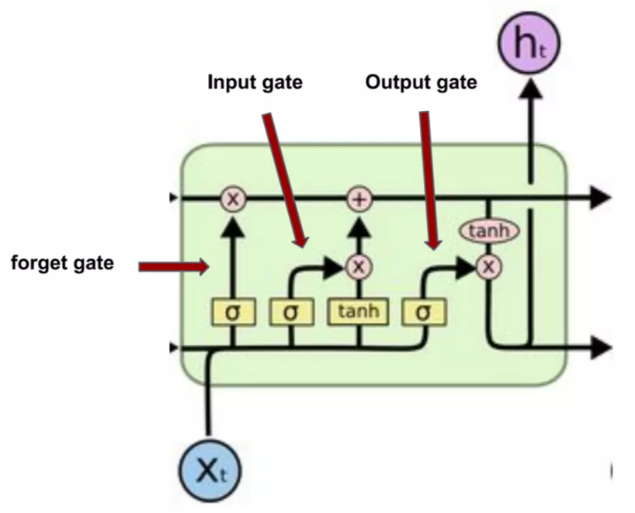
understanding the working of Lstm
How it Works? (LSTM)
The key to LSTM is the Memory Cell state which stores the information. It runs straight down the entire chain.
LSTM has the ability to remove or add information to these cell state, regarded by structures called gates.
Gates are composed of sigmoid neural net layer and a multiplication operation.
Sigmoid layer outputs are zero or one.
It consists of 3 gates: Input Gate, Forget Gate, Output Gate.
Fig 1: LSTM Architecture

Slide 12
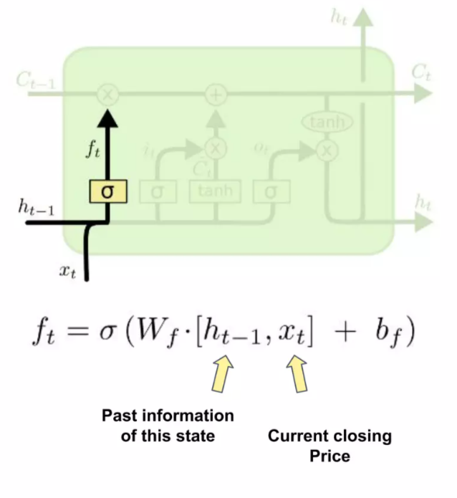
understanding the working of Lstm
First,
Forget gate looks at h_{t-1} and x_{t} and outputs a number between 0 and 1.
‘1’ represents keep the information
‘0’ represents remove the information.
Fig 2: Working of Forget Gate

Slide 13
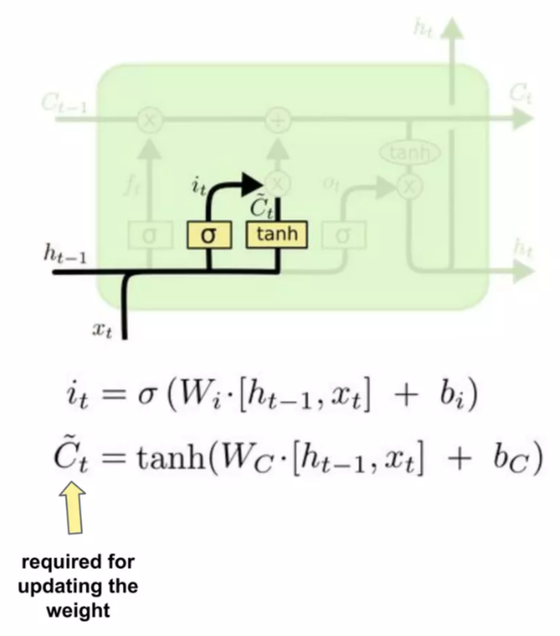
understanding the working of Lstm
First,
Forget gate looks at h_{t-1} and x_{t} and outputs a number between 0 and 1.
‘1’ represents keep the information
‘0’ represents remove the information.
Second,
Input gate decides which values
will be updated, in order to do that a tanh layer creates a vector of C_{t} (bar).
Combining these two, create an update to
the state.
Fig 3: Working of Input Gate

Slide 14
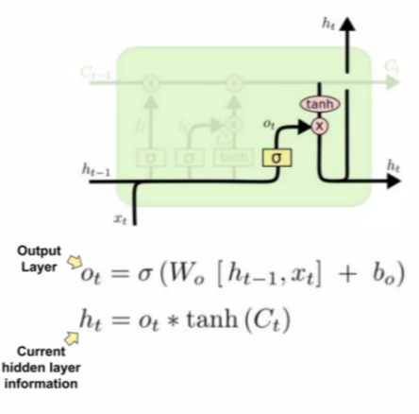
understanding the working of Lstm
First,
Forget gate looks at h_{t-1} and x_{t} and outputs a number between 0 and 1.
‘1’ represents keep the information
‘0’ represents remove the information.
Second,
Input gate decides which values
will be updated, in order to do that a tanh layer creates a vector of C_{t} (bar).
Combining these two, create an update to
the state.
Third,
It’s time to update the old cell c_{t-1} to c c_{t}
Fourth,
Output will be based on our cell state.
A sigmoid layer will decide what parts of the cell state we are going to output.
Fig 4: Working of Output Gate

Slide 15
VISUALIZING MULTIPLE ASPECTS OF DATA

Slide 16
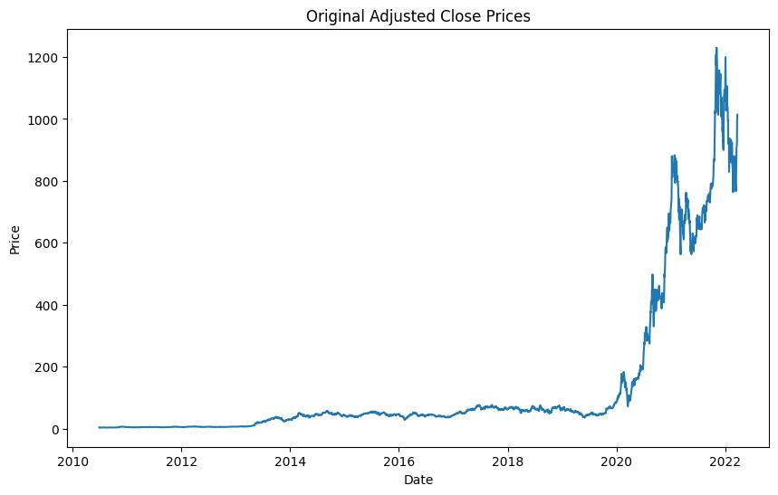
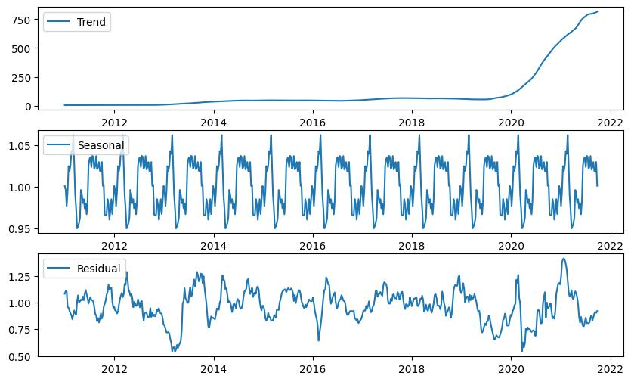
Fig 5: Original Closing Price Graph
Fig 6: Seasonal Decomposition of the Data Graph

Slide 17
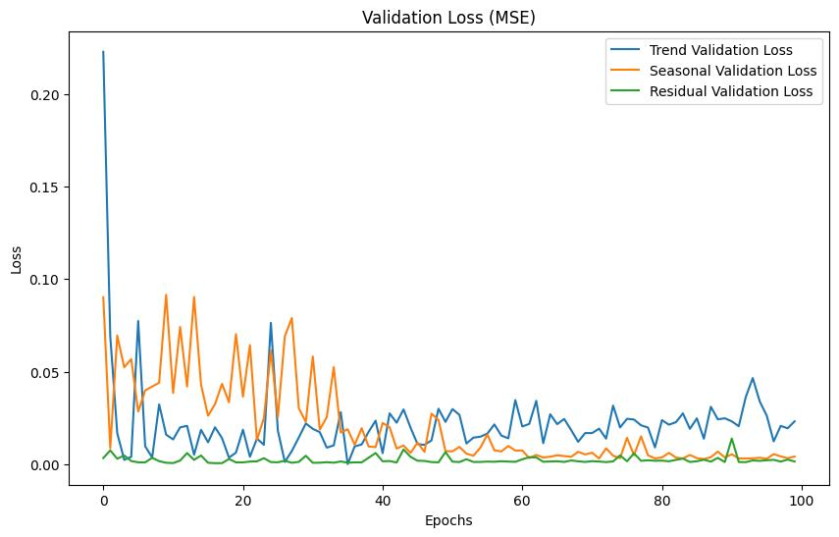
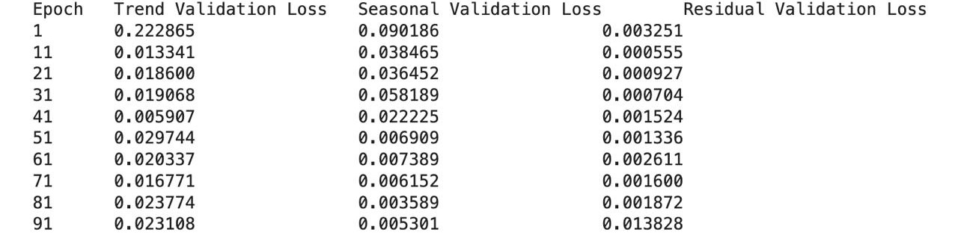
Fig 7: Validation Loss Graph
Table 2: Validation Loss in Tabular Form

Slide 18
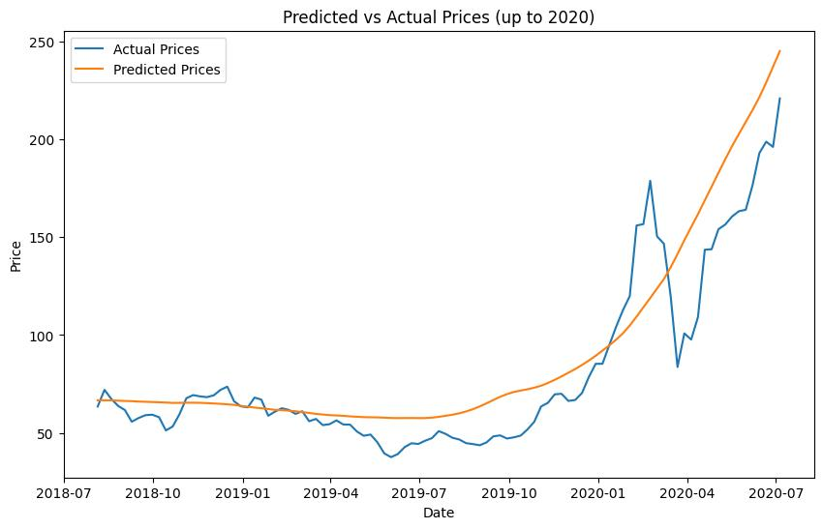
final result
Fig 8: Actual vs Predicted Graph

Slide 19
conclusion
Challenges in Stock Market Prediction: No model can guarantee successful predictions due to the complexity and numerous influencing factors.
Importance of Preprocessing Techniques: Effective preprocessing, like decomposing and differencing for stationarity, enhances model performance.
LSTM’s Strengths: LSTM models capture long-term dependencies, making them effective for sequential data in time series forecasting.
Component-wise Model Training: Training LSTM on decomposed components (trend, seasonal, residual) allows for detailed and accurate forecasting.
Comparative Analysis for Better Decisions: Comparing various time series models is crucial for making informed stock trading decisions to minimize losses and maximize profits.

Slide 20
future scope
Focus on Public Sentiments: Integrate sentiment analysis from social media and financial news to enhance stock price predictions.
Hybrid Model Development: Develop a hybrid model combining historical data with sentiment analysis for more accurate forecasting.
Incorporate Environmental Factors: Include environmental factors like floods and storms in prediction models to improve accuracy.
Expand to Cryptocurrency: Extend the application to predict cryptocurrency trading using time series and sentiment analysis.
Enhance Predictive Models: Continuously refine predictive time series models for higher accuracy in stock market forecasting.

Slide 21
thank you!

